Slide 1
How the internet works (the short version)
Communication Systems / Network Technologies
EIT5 / COMTEK5 2024
Aalborg UniversiTY

Slide 2




About Me
Martin Fejrskov Andersen, mfea@telenor.dk
M.Sc. In Communication Networks/Distributed Real Time Systems, AAU, 2005
SW Developer / Product Manager /Architect at ETI / BAE Systems 2005-2014
Developed products for wiretapping / lawful intercept for intelligence agencies, police authorities and internet service providers
Software development, product management for a product team of ~15 persons, Scrum/Kanban, technical presales activities, quality assurance etc. with focus on the ISP related portfolio
Solution Architect at Telenor 2014-
DNS, DDoS protection, DHCP, Lawful Intercept, Radius, MySQL, VoWifi, Linux, Tacacs, log collection, scripting, infrastructure security, customer protection, geo-redundancy, data retention, privacy, master student project proposal / co-supervision
Industrial PhD student at Telenor / AAU, 2019-2022
Overall theme: Detecting malware and cyber attacks using ISP data
Legal aspects, privacy/anonymization, DNS infrastructure, NetFlow, DNS blacklists

Slide 3
AgenDA
Introduction to protocols, concepts and devices
The packet oriented perspective using Wireshark
Exercises
Introduction to the architecture of the Internet, seen from an Internet Service Provider perspective
Examples of physical vs. Network topology
How the different parts of the internet are connected to Internet Service Providers (ISPs)
How subscribers are connected to ISPs
Consider all of the above as an introduction to a vast array of topics, so that you feel confident in diving deeper into individual protocols/concepts in the rest of the course, without fear of loosing track of the big picture.

Slide 4
Motivation
”I don’t care about networks, I just want to code <something>”
You will most likely never create any system, that does not in any way require connectivity with another device
The Internet is just a very, very often seen example of enabling such connectivity, and is therefore used as example in this lesson
It is often very easy to create any system that does not in any way interact with any external party, therefore noone will pay an engineer to do it
To be succesfull as an engineer, you need to have knowledge of domains adjacent to your primary domain

Slide 5
Internet Protocols, Concepts and devices

Slide 6
Common Network DEVices
Typical icons on diagrams:
Divided by OSI layer:
Physical layer: Hub, bridge
Datalink layer: Switch, wireless access point
Network layer: Router, layer 3 switch
Transport layer: NAT devices, old-school firewalls, load balancers
Upper layers: End user equipment (laptop/phone), many types of ”layer 7” firewalls, support protocol equipment (DNS servers etc.)
Notice that ”layer N” devices also typically implement the layers below layer N, however the opposite is not typical

Slide 7
Common Network Concepts
LAN (Local Area Network):
A network consisting of hubs/switches
The network between the user equipment and the nearest router
Sometimes referred to as a ”broadcast domain”
Typically characterised by a specific range of IP addresses, for example a 10.0.0.0/24 network
WAN (Wide Area Network):
Typically a synonym for ”the rest of the internet”
Backbone
The parts of the network that connect different LANs, maybe with a connection to a WAN
The routers and switches owned by Telenor is an example of backbone infrastructure
Tunnel
IPSec, GRE, PPP, MPLS and other technologies
A method for making intermediate router hops invisible to the endpoints by exploiting the layered protocol structure
For example, to create a layer 2 connection across a layer 3 network
NAT (Network Address Translation)
A method to allow several devices to share a single IP address as seen from the WAN (a ”public” IP address)
Devices are assigned a 10.0.0.0/8, 172.168.0.0/12 or 192.168.0.0/16 IP address on the LAN (a ”private” IP address)
Conceptually very different from a firewall, but will in some cases provide the same functionality
Typical icons on diagrams:
Layer 1 connectivity
(a wire)
Tunnel
LAN or WAN (depending on context)

Slide 8
Common protocols
Network
Data Link
Ethernet
Data Link layer protocol
Primary concept: Source and destination Medium Access Control (MAC) address
VLAN (Virtual Local Area Network): Used to create virtual layer 2 networks sharing the same physical layer
IP (Internet Protocol)
Network layer protocol
Primary concept: Source and destination IP address
ARP (Address Resolution Protocol): Used by devices to learn the Ethernet MAC address (link layer address) of other devices
ICMP (Internet Control Message Protocol): Used for error signalling, verifying connectivity (pings) and much more
Physical

Slide 9
Common protocols
Transport
Network
Data Link
TCP (Transport Control Protocol)
Transport layer protocol
Primary concept: Source and destination port (for example ”port 80” is reserved for HTTP traffic, ”port 443” is reserved for HTTPS traffic), connection establishment and retransmission
UDP (User Datagram Protocol)
Transport layer protocol
Primary concept: Source and destination port (as TCP), concepts like ”connection” and ”session” must be handled by upper layers
Physical

Slide 10
Common protocols
Application
Application
Presentation
Session
Transport
Network
Data Link
TLS (Transport Layer Security)
Application layer protocol (OSI would probably say Session Layer)
Primary concept: Provides encryption and authenticates endpoints
HTTP (HyperText Transport Protocol)
Application layer protocol
Primary concept: Used to request the individual parts of a web page
HTTPS: HTTP transported over TLS
QUIC (just a name, not an acronym)
Transport layer protocol (OSI would probably say Session)
A newer protocol designed to reduce the TCP and TLS setup time. Allows the multiplexing of several connection on a single UDP session
Primary concept: Connection ID (remains constant across for example IP address changes)
Uses UDP as underlying transport, is always end-to-end encrypted.
Physical

Slide 11
Common protocols
Application
Application
Presentation
Session
Transport
Network
Data Link
STP (Spanning Tree Protocol)
Data Link layer protocol
Used by managed switches to avoid traffic loops
DHCP (Dynamic Host Configuration Protocol):
Application layer protocol (why is this a bit weird?)
Used by a device to:
Obtain an IP address (network layer address) for itself
To learn the IP addresses of the DNS server
To learn the IP address of the ”default gateway”
DNS (Domain Name Service):
Application layer protocol (why is this not weird?)
Used by a device to learn the IP address associated with a domain name
Physical

Slide 12
A simple web page visit
Open the file ”web page visit.pcapng”
Scenario:
Wireshark Dump is started on laptop
Laptop is connected to home broadband router
A browser is used to visit https://fejrskov.net
Let’s walk through the file and see what is actually transmitted…

Slide 13
Theory vs the real world
Although real, the previous pcap file example was simpler than what you can expect to see
Let us try a 1 minute packet dump from my office laptop
I do not interact with the computer during the dump. Everything we see is ”backscatter”…

Slide 14
ExerCises

Slide 15
Exercises
Exercise 1:
Do a dump of the traffic on your own laptop, try to explain to the guy next to you what is going on
Exercise 2:
Your grandmother complains that sometimes, the Danske Bank website does not work
The broadband router is assigned the IP address 85.83.193.234 by the ISP (seen from a visit to https://myip.com )
You start a wireshark dump on her PC and connect the PC to the broadband router
To help debugging, you start a ping towards the Danske Bank website
The wireshark dump is found in the file “error.pcapng”
Analyse the pcap file to find the likely cause of her problem

Slide 16
Short introduction to the architecture of the Internet
Seen from an Internet Service Provider perspective

Slide 17
delimitation
The architecture of the Internet depends heavily on which OSI layer you look at, and where you look
For this presentation:
Examples of physical vs. Network topology
How the different parts of the internet are connected to Internet Service Providers (ISPs)
How subscribers are connected to ISPs

Slide 18
Physical vs Network layer topology

Slide 19
Physical vs Network layer topology
A picture of the physical topology rarely matches that of the datalink-layer topology or the network-layer topology
A single fiber can contain many different LANs through the use of WDM technology (Wavelength Division multiplexing)
A single port in a switch can be related to many LANs through the use of VLAN tagging
Typical for companies within smaller geographical regions
A single port in a router can be related to many LANs through the use of VLAN tagging or/and Multi Protocol Label Switching (MPLS)
Typical for internet providers or companies spanning large/many geographical regions

Slide 20
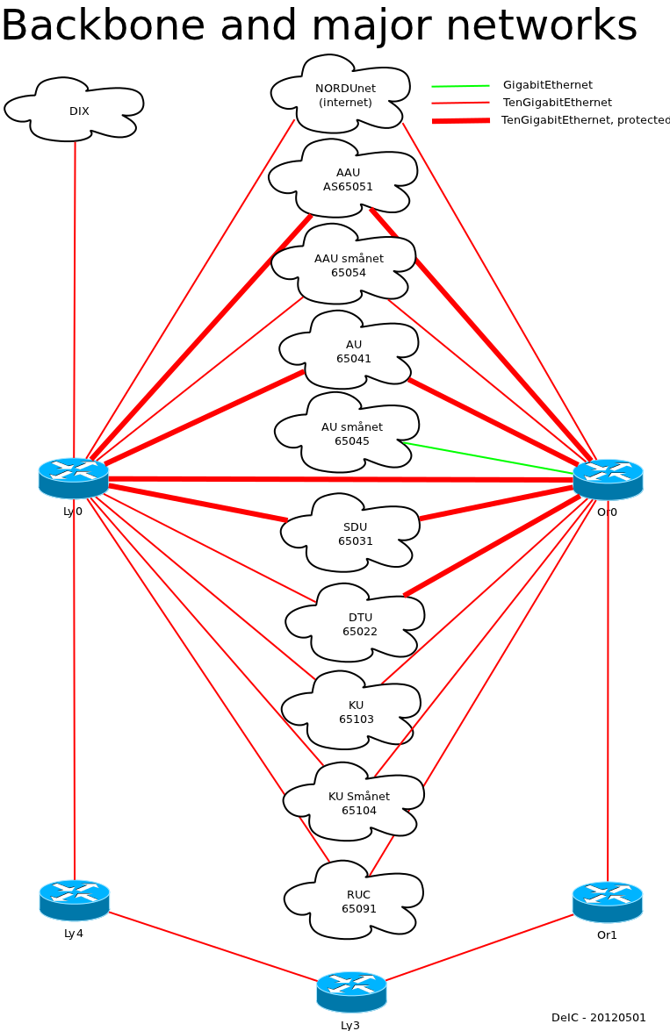
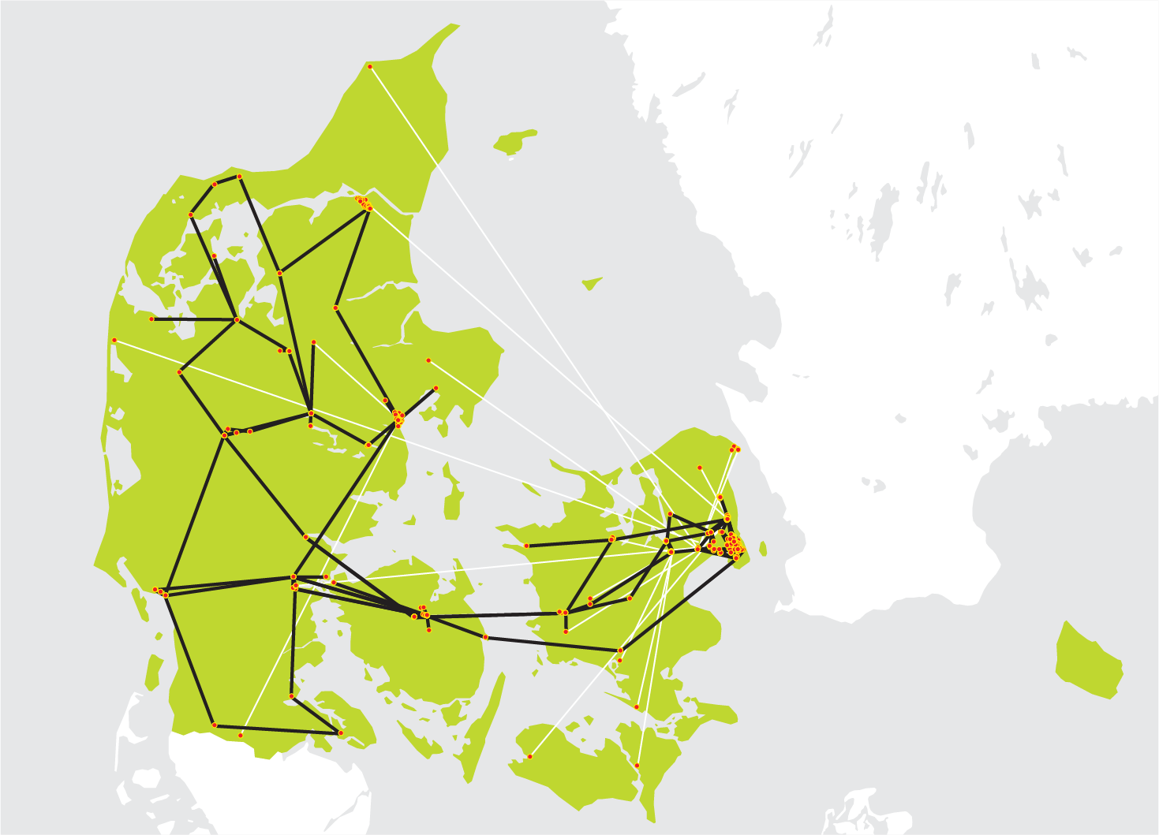
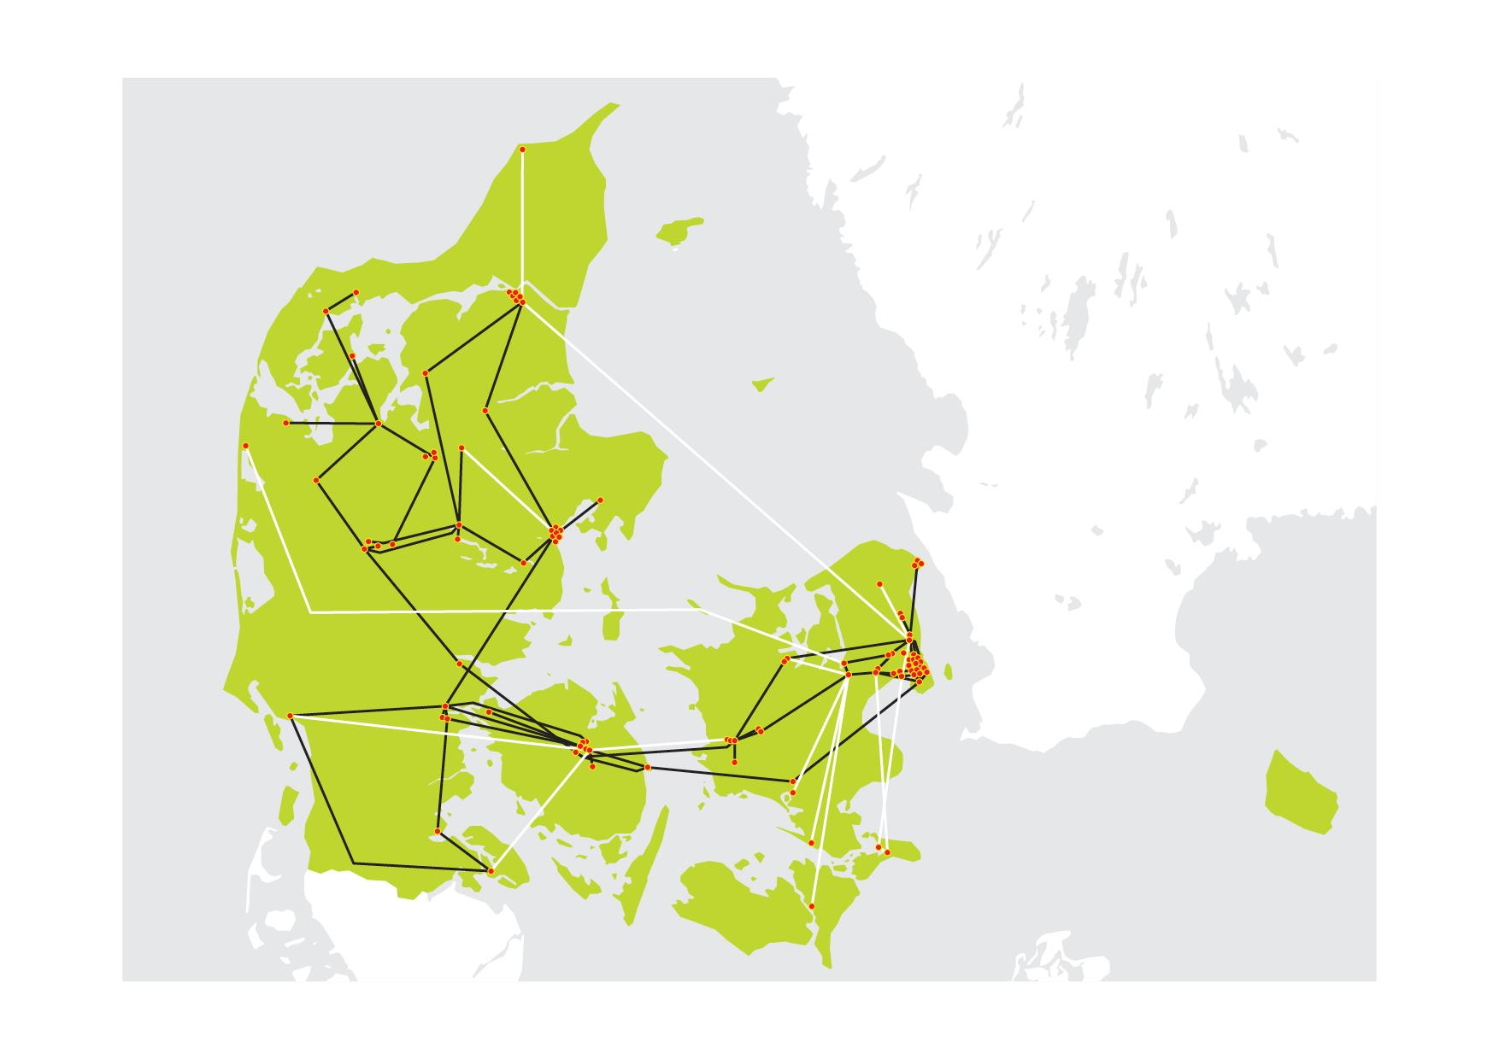
Danish Research Network
https://www.deic.dk/da/forskningsnet

Slide 21
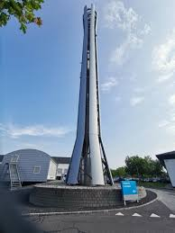
Telenor Network
Equipment:
~400 WDM (Wavelength Division Multiplexing) nodes
~1000 Microwave transmission nodes
~2000 cell site routers/switches
~70 backbone routers
Locations:
~30 with backbone routers
~4000 cell towers
Fiber
Telenor does not own much fiber, most is rented at companies specializing in providing fiber infrastructure, for example GlobalConnect, TDC

Slide 22
How are parts of the internet connected?

Slide 23
Autonomous systems
The Internet consists of many Autonomous Systems (AS), typically Internet Providers or larger companies
Example AS: Aalborg University (AS65051), Telenor DK (AS9158)
An AS owns a set of IP addresses, delegated to that AS by APNIC, ARIN, RIPE NCC, LACNIC, and AFRINIC (the 5 Regional Internet Registrars (RIR))
The Internet has around 100.000 AS’es
Find your own, public IP address using for example https://myip.com, and use https://ripe.net to see which AS owns that IP

Slide 24
PEERING
Autonomous Systems can exchange traffic
Publicly: At an Internet Exchange (IX)
An example: Danish Internet Exchange (DIX)
Basically an organisation that owns (typically) a few routers and switches in a limited geographical region, and offers (physical) connections for a fee
Privately: By having one or more direct (physical) connections between the two networks
An example: Telenor connects directly to TDC, AAU connects directly to the Danish Research Network
Typically free (except for the physical equipment owned by each network, of course)
Exchanging traffic between two AS’es where the source and destination addresses are within those AS’es is called ”peering”
A special type of peering is the peering with Content Delivery Networks, which typically involve peering with ”a rack full of servers” operated by Netflix, Akamai, Google etc.

Slide 25
Transit
For all AS’es to have peerings with all other AS’es is impractical/impossible
Some companies (AS’es) have a business in providing connectivity through their own network to all other networks for a fee
Examples: Cogent, Spring, Telia Carrier, Lumen (formerly Level 3 / centurylink)
This type of traffic is called ”transit” traffic, and the provider is called a ”transit provider”
Consider it the Internet Provider’s Internet Provider

Slide 26

The economy of peering and transit
Transit connections are typically expensive, and typically price based on the amount of traffic, secondarily on the amount and type of physical interface
Peerings are typically cheaper, but you need a lot of them
An Internet provider will typically create peerings with the AS’es with which the Internet provider exchanges the most traffic
As an example, Telenor receives around 700Gbps traffic, of which around half is from CDN peerings, and a third is from ”normal” peerings, leaving around a sixth of the traffic for the transit connection

Slide 27
Routing
An AS announces its IP address ranges that can be reached by sending traffic to that AS
In a peering situation, an AS announces its own IP addresses only
In a transit situation, an AS announces its own IP addresses and the IP addresses of other AS’es, that can be reached through transit
In practice, the AS border router of an AS announces the IP address ranges using the (exterior) Border Gateway Protocol (eBGP)
Within an AS, routers announce reachable IP ranges with whatever protocol the administrators of the AS likes.
Telenor example:
The Intermediate System to Intermediate System (IS-IS) protocol is used to connect routers
Multi Protocol (MP)-BGP enables Multi Protocol Label Switching (MPLS) VPNs
Ressource Reservation Protocol – Traffic Engineering (RSVP-TE) enables predefined backup routes for fast failover
Let’s try an example on the whiteboard…

Slide 28
How are subscribers connected to ISPs?

Slide 29
Basic connectivity options
Physical options (depends on what is available at a customer site)
DSL
Coax
Fiber (GPON or direct)
4G/5G radio
Various protocols and equipment for AAA, which depends heavily on the physical connection:
Authentication: Is the subscriber who he claims to be?
Authorization: What resources can the subscriber use? (speed, GB limit, QoS, network)
Accounting: What resources does the subscriber consume? (IP address, number of GB and other stuff typically for billing purposes)
Implemented in a Broadband Network Gateway (BNG) for most broadband subscribers
Implemented in a Packet Gateway (PGW) for mobile 4G/5G subscribers
The modem/router/wifi thingy supplied by the ISP is in a general term called Customer Premises Equipment (CPE)
We shall use Telenor customers as examples

Slide 30
DSL connectivity
Digital Subscriber Line (DSL) connectivity through the ”phone line”, available in almost every household for historical reasons
TDC Net owns all the physical phone lines in Denmark going from a household to the nearest (TDC owned) tech hut
TDC Net is forced (by law) to allow other ISPs to get (paid) access to the phone lines
Varying price models (see wholesale.tdc.dk) depending on if TDC should also provide modem, DSLAM, internet connectivity to other ISPs as well etc.

Slide 31
Coax connectivity
”Internet through the TV cable”
Physical cables almost exlusively owned by either Norlys (Stofa) or TDC Net
No access to Norlys Coax for other ISPs. They would rather close it down than allow other ISPs to access it…
TDC Net enforces use of their CPEs, therefore no PPP option, therefore no way to distinguish customers (to employ AAA) at the Telenor end

Slide 32
Fiber connectivity (direct)
Connectivity directly from customer equipment to a switch/router in the ISPs backbone using plain Ethernet
However, typically with some speed limit enforced by the ISP’s switch/router
Only used for business customers
IP address allocation:
Statically allocated IP address(es)
Customers own IP address range (if customer has his own AS number)
Relatively straightforward, but relies on direct physical connectivity being established by the ISP or the customer (or rented at GlobalConnect or similar companies), which is expensive (could even be through Microwave link)
Resembles how you connect (through cable) to the university network or a company network (although those typically employ DHCP and a MAC address check as well)

Slide 33
Fiber connectivity (GPON)
Fiber To The Home (FTTH)
Physical cables owned by the traditional energy companies (Eniig (Norlys), Ewiig, etc.) or TDC Net, or a number of smaller companies
Implementation varies, TDC Net and Eniig (Norlys) used as examples

Slide 34
4G/5G connectivity
In Denmark, 3 different companies own 4G/5G cells: TTN, TDC Net and Hi3G (”3”)
Norlys (Telia) and Telenor jointly own TTN (TeliaTelenorNetwork)
Notice that the example below is extremely simplfied wrt. radio/frequency properties, mobility signalling, number of switches/links traversed etc.

Slide 35
Summary
Introduction to protocols, concepts and and devices
The packet oriented perspective using Wireshark
Exercises
Introduction to the architecture of the Internet, seen from an Internet Service Provider perspective
Examples of physical vs. Network topology
How the different parts of the internet are connected to Internet Service Providers (ISPs)
How subscribers are connected to ISPs

